Slide 1





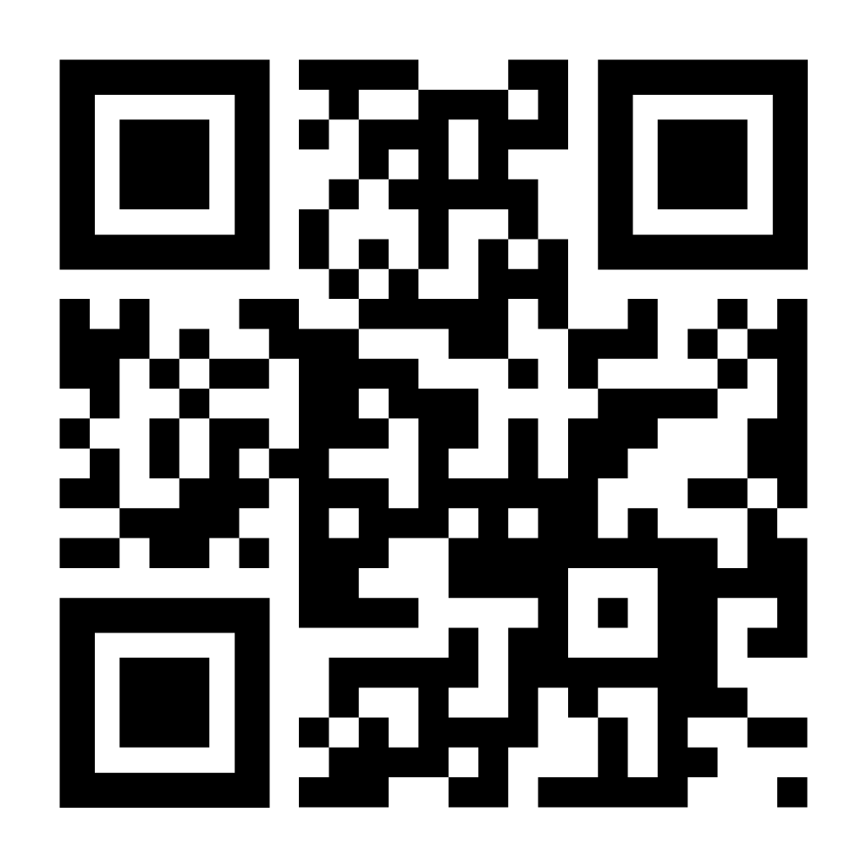
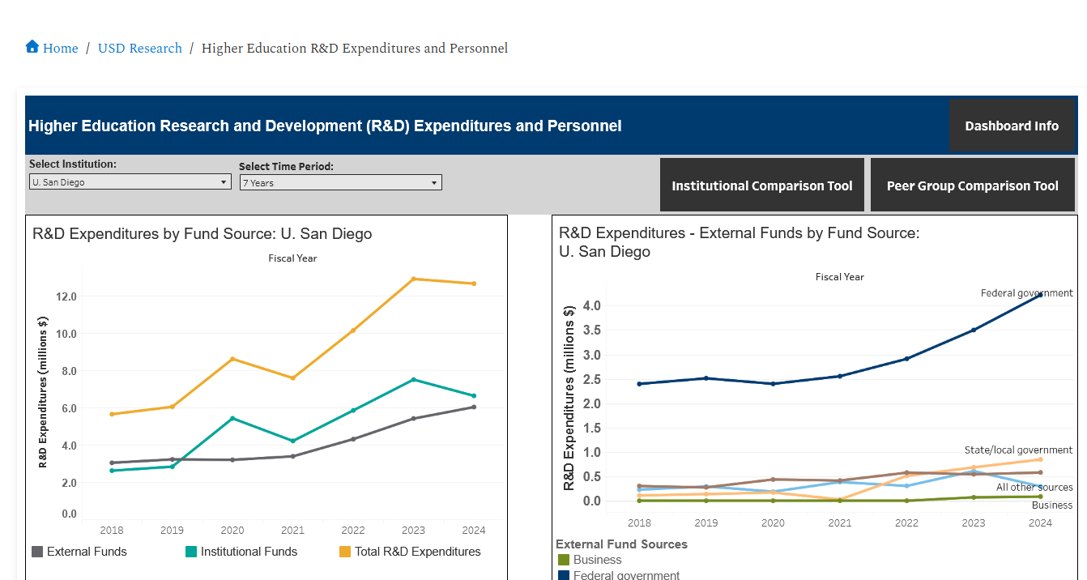
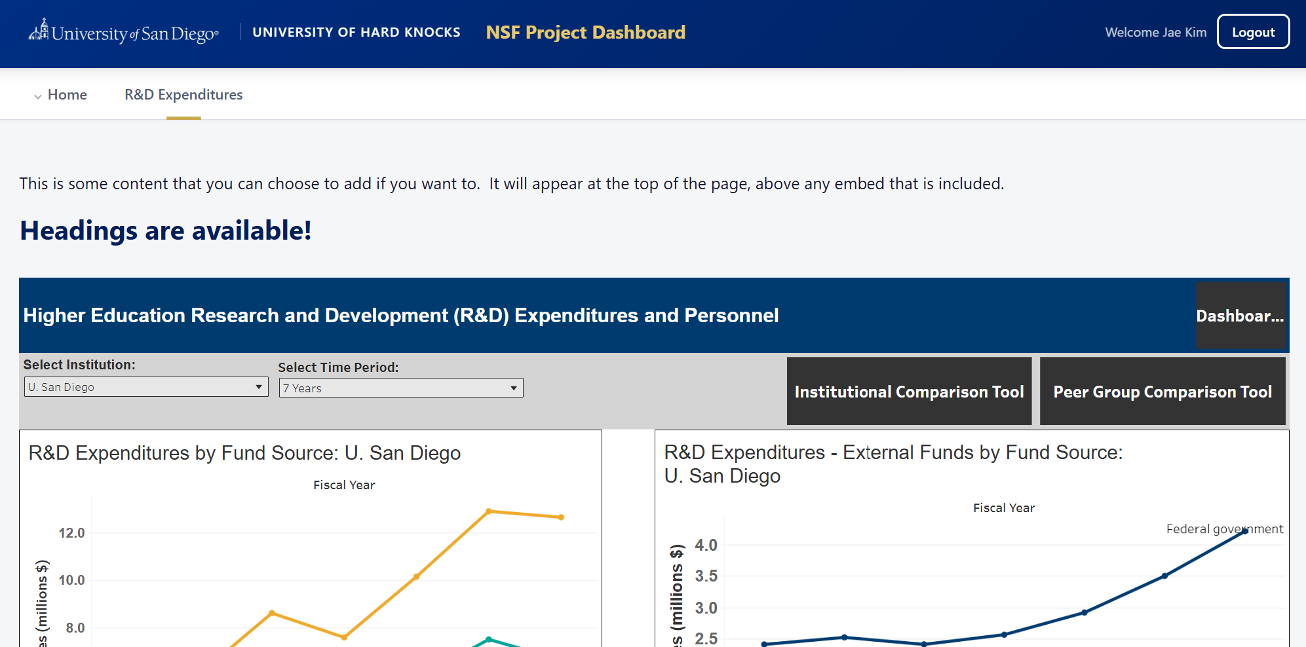
NSF GRANTED • AWARD #2528426
ResDataNexus
Automate the extraction, mapping, and visualization of your institution’s research metrics — HERD data, research publications, and sponsored program activity — with minimal IT or technical resource requirements.
Now available: HERD Dashboards — choose your implementation route
1
Integrate into Existing Web Resources
2
“Turn-Key” Standalone Operation
Embed HERD dashboard components directly into your institution’s current research site.
Launch a fully hosted HERD Dashboard using webpage templates.
Scan for the GitHub repo
github.com/jaedkim23/granted
See the README for setup steps
Questions? Truc Ngo tngo@sandiego.edu Jae Kim jaedkim@sandiego.edu Live on USD website: https://www.sandiego.edu/ire/usd-research/herd-dashboards.php

