Slide 1

Federal Awards
Federal Regulations and the Uniform Guidance
Federal Agency Policy and Terms & Conditions
Funding Program Requirements
State Rules and Regulations
NSHE Rules and Regulations
NSU Rules and Regulations
Notes:
As I said, OGAS manages all awards in compliance with OMB’s Uniform Guidance, even if they’re not federal grants. However, with federal grants, compliance with all the rules is mandatory – punishable by prosecution, fines and sometimes incarceration.
There are many layers of rules and regulations the PI and OGAS need to be familiar with and live by. (Read from the slide)

Slide 2

Federal Awards
Office of Grants Award Services
is here to help interpret the rules and regulations and keep you and NSU in compliance. OGAS has policies and procedures to help ensure compliance – but there are some requirements OGAS can’t help with:
Training Your Research Team
Disclosing Conflicts of Interest
Disclosing Other Supports
Notes:
We are here to help you – but some things we can’t do: we can’t do your research; we can’t prepare your program reports; and we can’t manage your day-to-day implementation of your project. So – be aware there are certain rules and regulations that only you can be responsible for that aren’t very obvious – so we want to point them out now, and give you a hand-out to consult later. (Next Slide, while reviewing handout)

Slide 3
Principal Investigator Must
Train the Research Team
Responsible Conduct of Research
Research Security
Disclose Any Changes
Changes in Other Support
Changes in Effort
Changes in Academic or Professional Appointment
Disclose Any Conflicts
Maintain Project Documentation for three (3) years after Close of Award
Notes:
NSU has written policies on many of these, and OGAS and the Office of the Provost are working on developing policies for the new requirements. Until then, you’ve got the handout

Slide 4

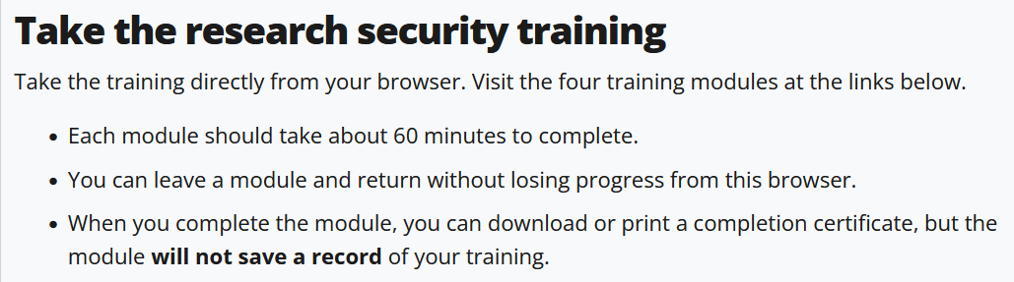
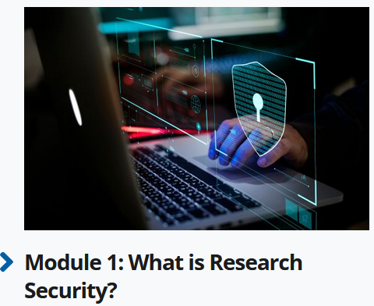
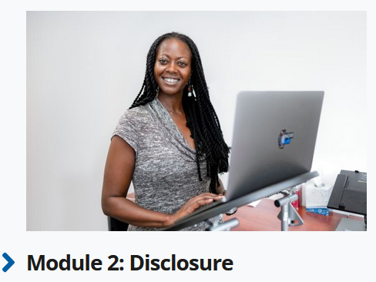
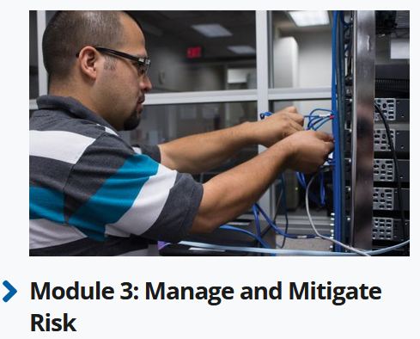
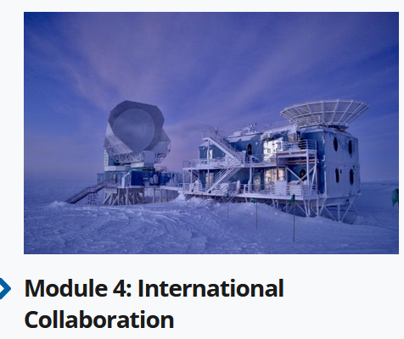
Research Security
Cybersecurity
Foreign Interests
How to Identify Risks
NSF has a 4-Module Online Training series that covers everything the regulations require, and will provide a Certificate of Completion when completed: https://www.nsf.gov/research-security/training
Understand the Regulatory Landscape
Foreign Interference
The has a condensed, 1-Module RST that covers everything the regulations require: https://www.secure-center.org/resources
Notes:
So – what is Research Security? What needs to be covered? [Click through – 5 clicks give topics;]
[6th:] Fortunately, NSF has Research Security Training that covers everything that’s necessary, [7 & 8] – and it’ll give you a Certificate of Completion,
[then 9th ] And – there is a 1-module training available. Choose the depth of training appropriate for the research team member’s role

Slide 5



Disclosures
Reimbursed or Sponsored Travel by a Foreign or Domestic Entity
The PI must disclose changes in Other Support, Effort, Resources and Professional Appointment for self and other senior/key personnel.
Whether or not remuneration is received
Equity Ownership in an entity related to your NSU duties or field of experience
Any benefit you receive from a foreign entity, including income from seminars, lectures, or teaching engagements or income from service on advisory committees or review panels
Donated or In-Kind resources such as office/laboratory space, equipment, supplies, employees, etc.
https://grants.nih.gov/grants/guide/notice-files/NOT-OD-19-114.html
Notes:
The PI is responsible for keeping Disclosures up-to-date. Any changes in Other Support, Effort, or Resources need to be reported.
The Regulations specify that Other Support includes all financial resources, whether Federal, non-Federal, commercial or institutional, available in direct support of an individual’s research endeavors.
Disclose any changes by updating the Other Supports (Current and Pending) form or by updating your BioSketch. [Then click through]

Slide 6
Disclosures
Reimbursed or Sponsored Travel by a Foreign or Domestic Entity
The PI must disclose changes in Other Support, Effort, Resources and Professional Appointment for self and other senior/key personnel.
Whether or not remuneration is received
Equity Ownership in an entity related to your NSU duties or field of experience
Any benefit you receive from a foreign entity, including income from seminars, lectures, or teaching engagements or income from service on advisory committees or review panels
Donated or In-Kind resources such as office/laboratory space, equipment, supplies, employees, etc.
The PI must also disclose financial interests of individuals living in your household and family members up to the 3rd degree consanguinity
https://grants.nih.gov/grants/guide/notice-files/NOT-OD-19-114.html
Notes:
[Click to make “Family Members” get big, for emphasis]
Any Questions?
Now – back to talking about your Award and Workday.

