Slide 1
Creating an NSF-approved Biosketch with SciENcv
Wendy Pacheco
Pre-Award Lunch & Learn
Office of Grant & Contract Services
December 13, 2019
Notes:
Intro, Karen, Deandra, Sarah. Brooke Libr/ORCID, Janelle & Sandro - Provost DM

Slide 2
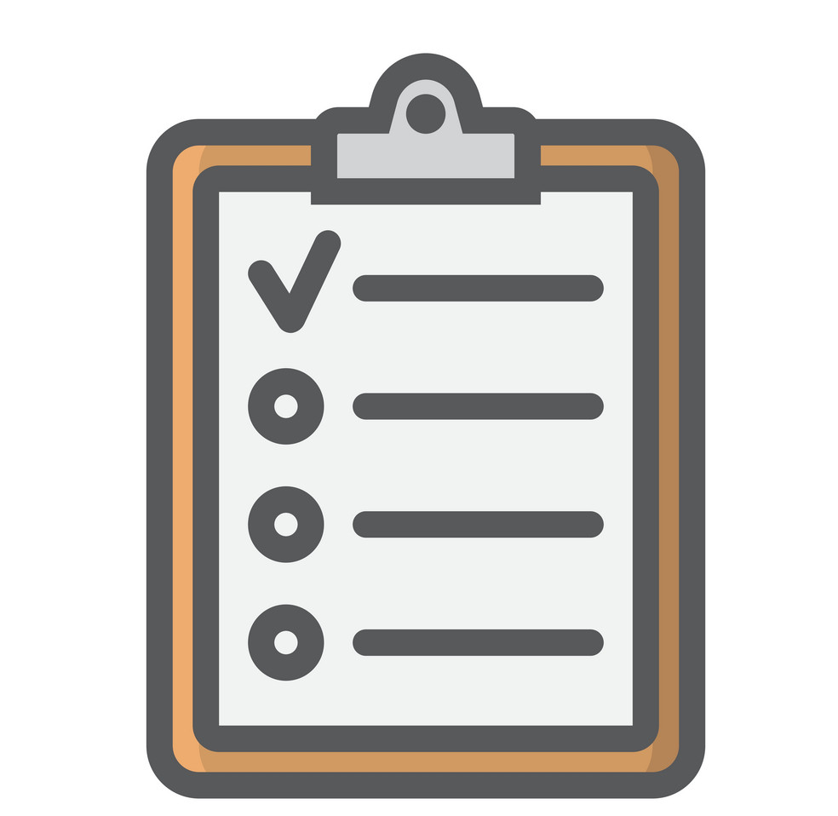
Agenda
What is SciENcv
Why it is important
How to log in
How to link accounts and add a delegate
How to create an NSF biosketch
Compliant NSF Biosketch
Q & A

Slide 3
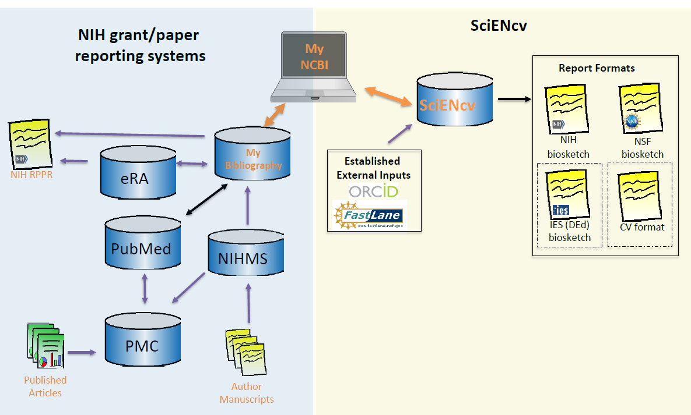
What is SciENcv?
Science Experts Network Curriculum Vitae (SciENcv)
Requested by the Federal Demonstration Partnership (FDP)
National Center for Biotechnology Information (NCBI)
Interagency working groups: DoD, DoE, EPA, NIH, NSF, USDA, etc.
US NLM
Notes:
Electronic system helps researchers assemble and maintain professional profile inf needed for fed fund apps
Cooperative project request by fdp assoc of academic instit and fed agencies
Built and operated by

Slide 4
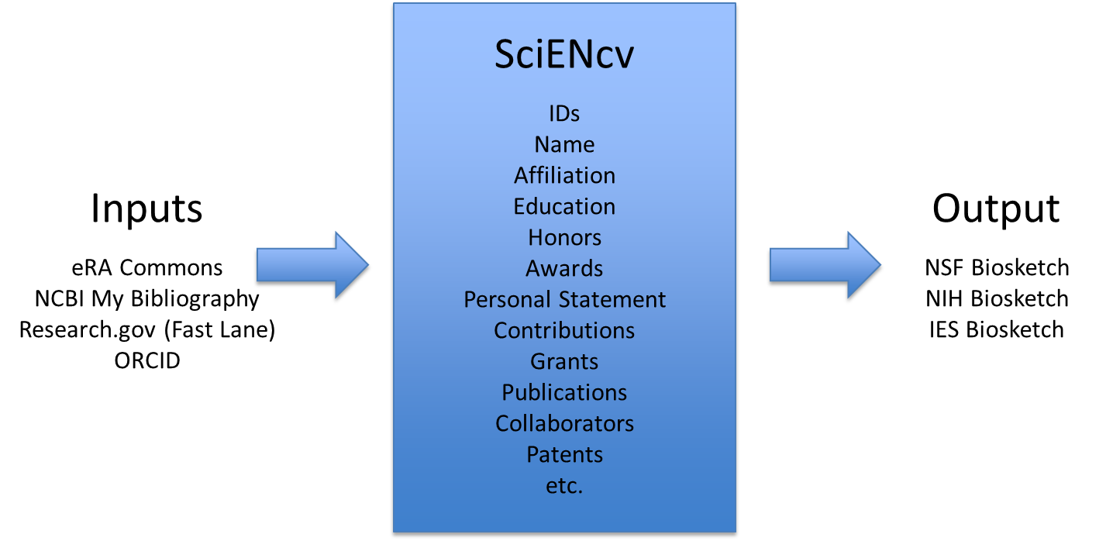
What does SciENcv do?
NEW NSF-approved format per 2020 PAPPG
Notes:
Imports, Inputs, Export
Upon the release of the New 2020 PAPPG NSF will only accept PDFs that are generated through use of an NSF-approved format (SciENcv) for biosketches

Slide 5
SciENcv benefits
Reduces the administrative burden
Eliminates repeatedly entering biosketch information
Allow researchers to describe their scientific contributions
Any researcher may register
Leverages data from existing systems
Researcher
controls what data are public
edits and maintains information
provides own data to describe research outcomes
has ultimate control over data in biosketch
Notes:
Tool to Manage multiple Biosketches

Slide 6
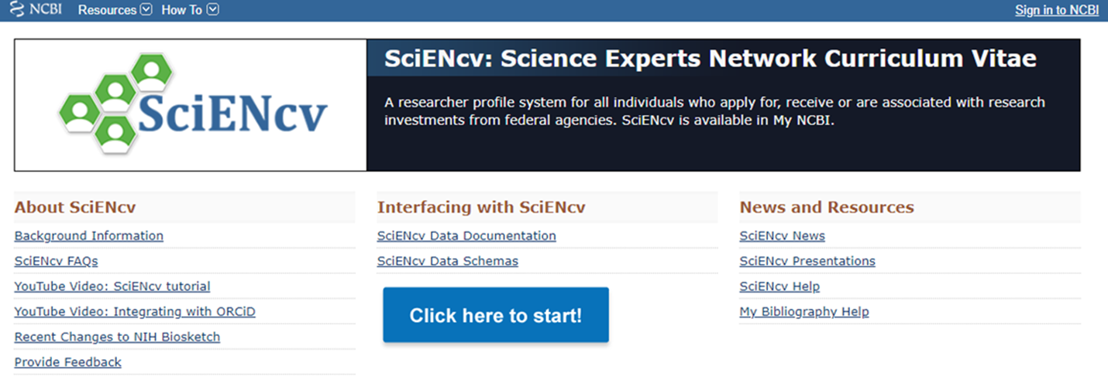
1. Log in
NCBI
SciENcv

Slide 7
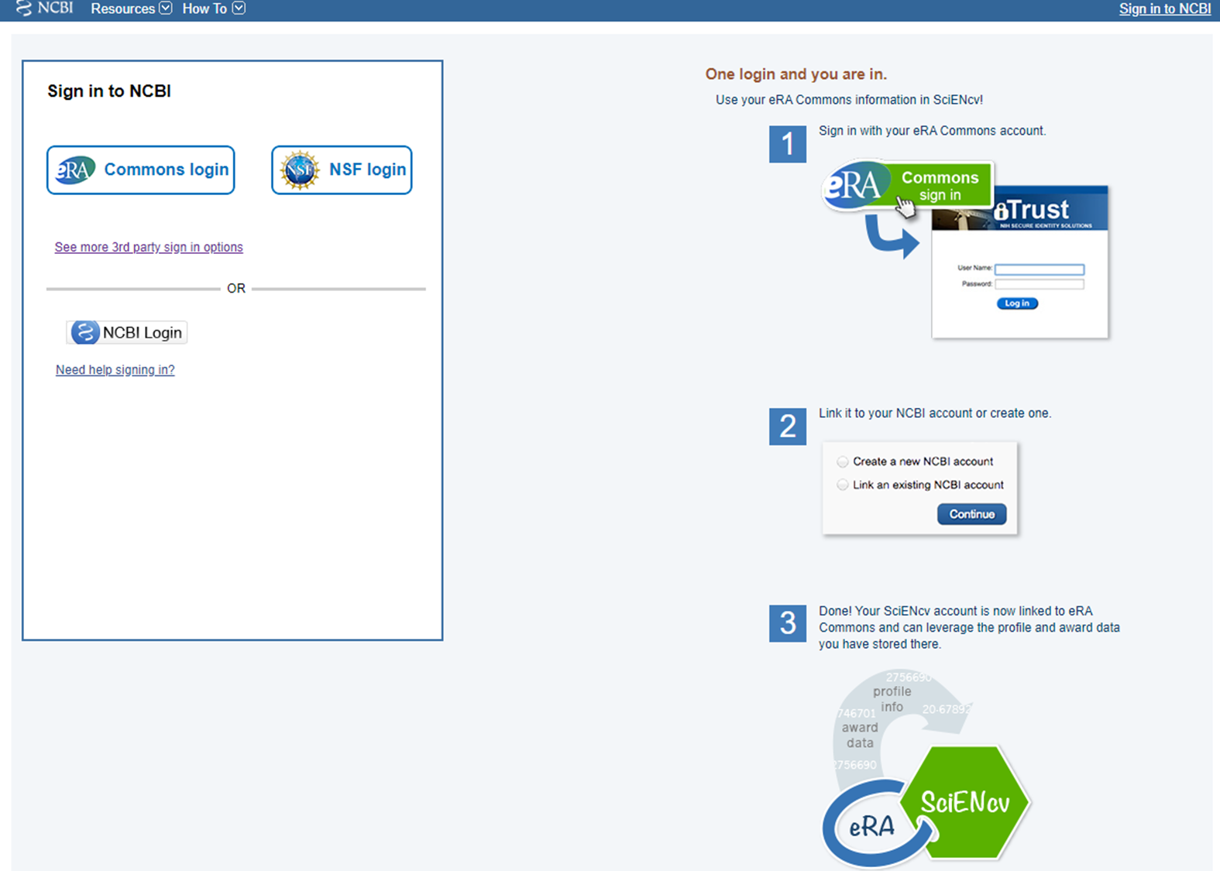
1. Log in
From SciENcv

Slide 8
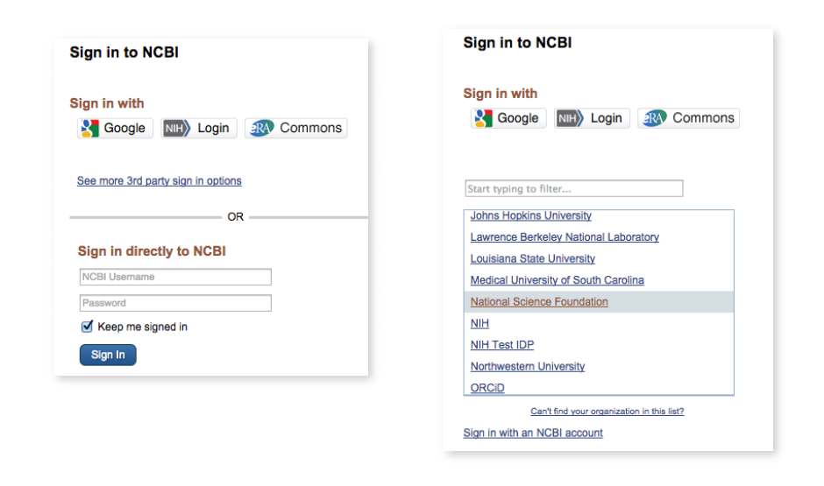
1. Log in

Slide 9
SciENCv main page

Slide 10
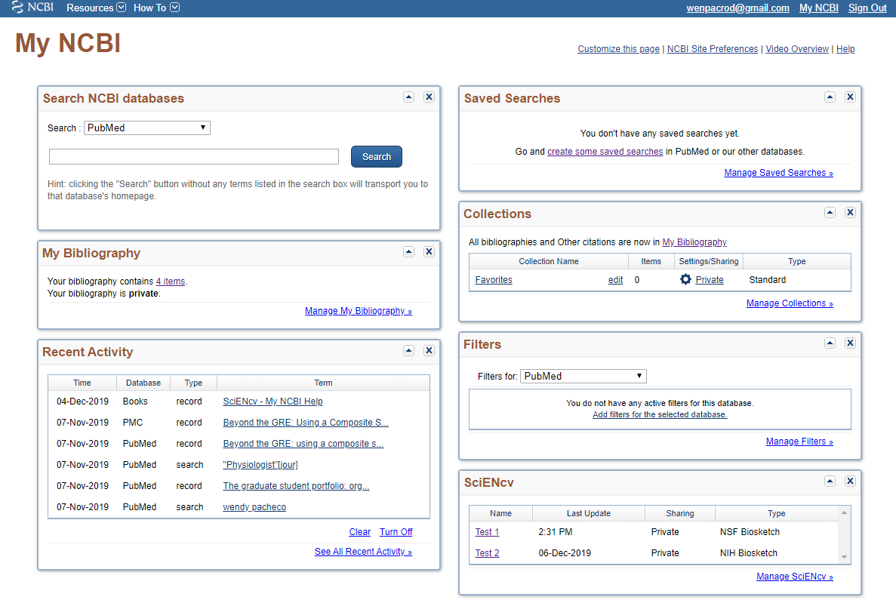
My NCBI dashboard

Slide 11
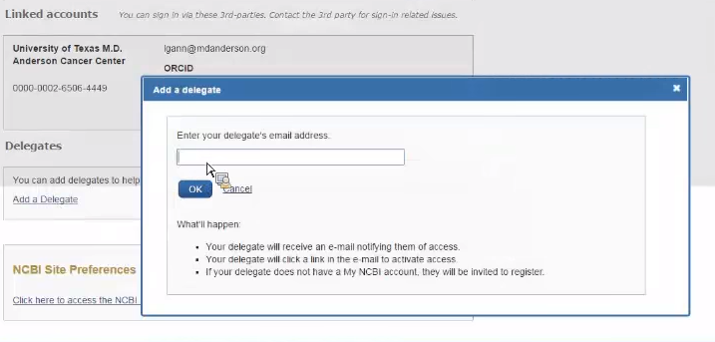
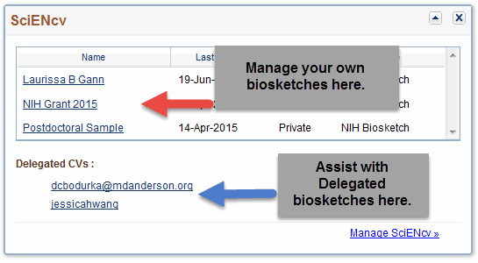
2. Assign delegates

Slide 12
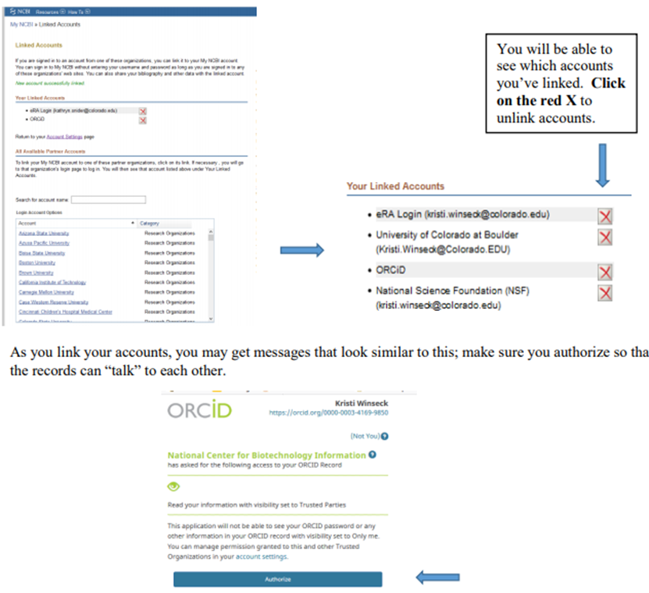
3. Link accounts
Under “All available partner accounts,” search for the partner organization you wish to link to your NCBI account.

Slide 13
SciENcv main page

Slide 14
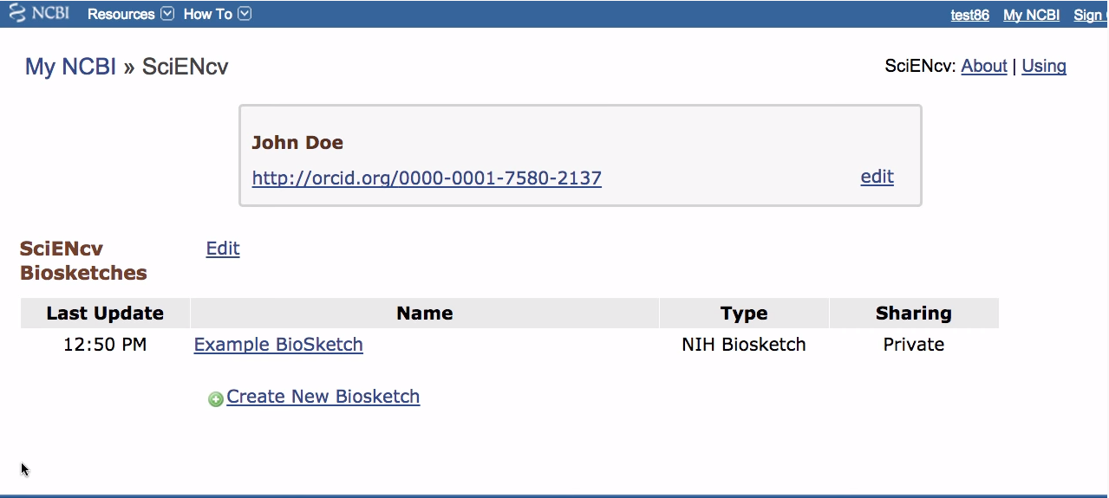
4. Edit Mini Profile on SciENcv main page
Notes:
ORCID POPULATES = ORCID accts will be mandatory for Ts, R25, now K & F

Slide 15
SciENcv main page

Slide 16
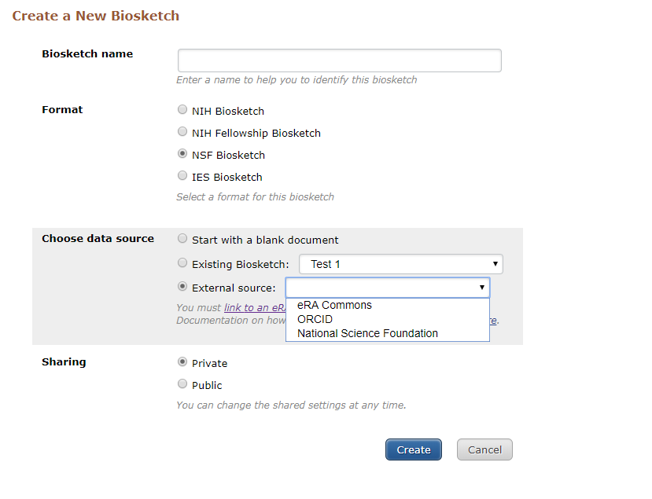
5. Create a New Biosketch
Notes:
ORCID populates

Slide 17
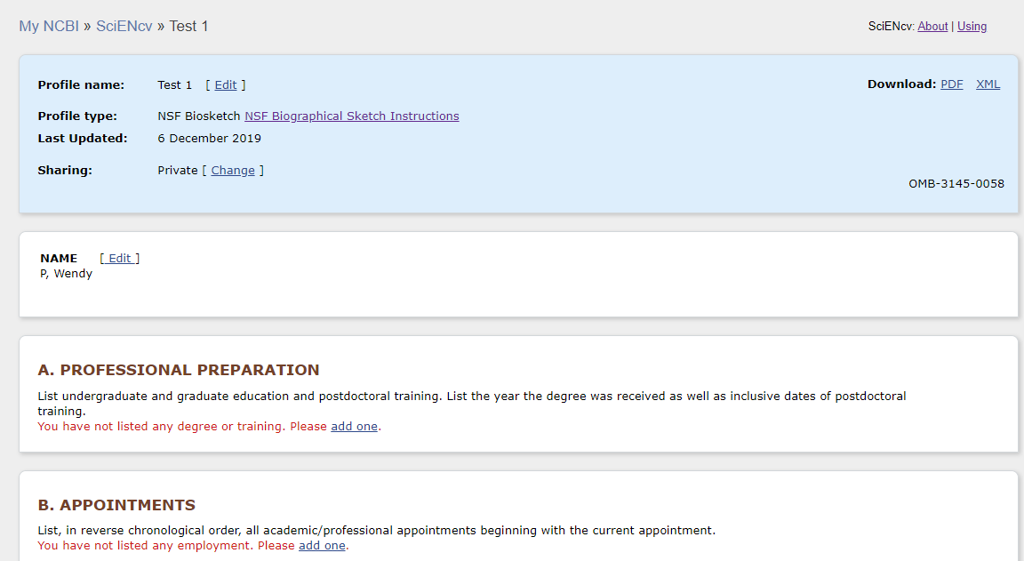
6. Enter sections

Slide 18
6. Enter sections

Slide 19
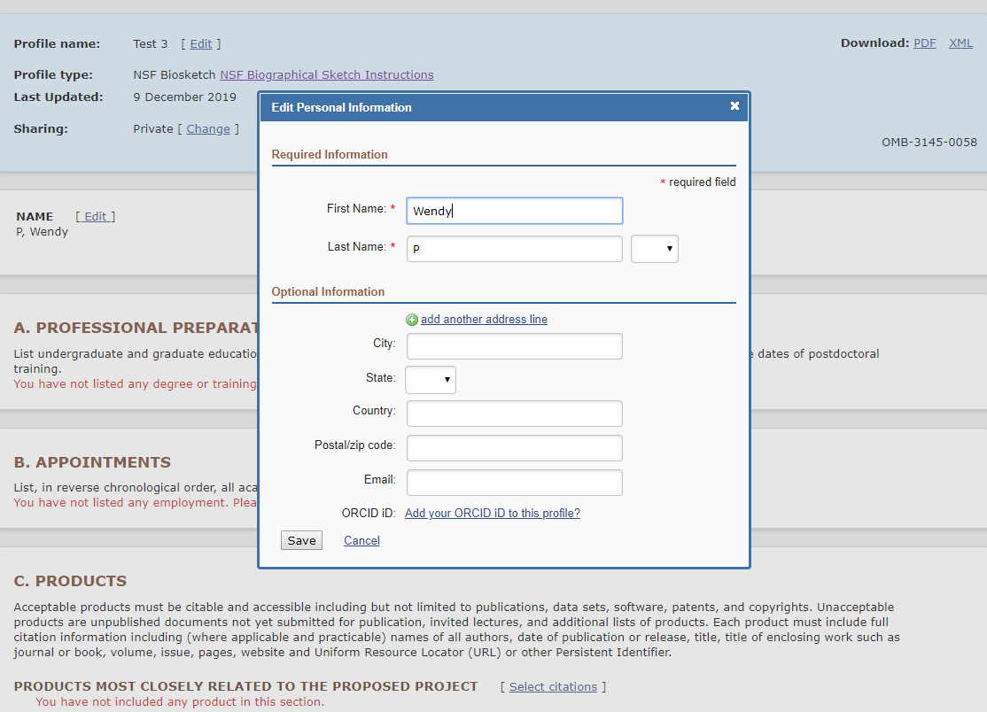
7. Name

Slide 20
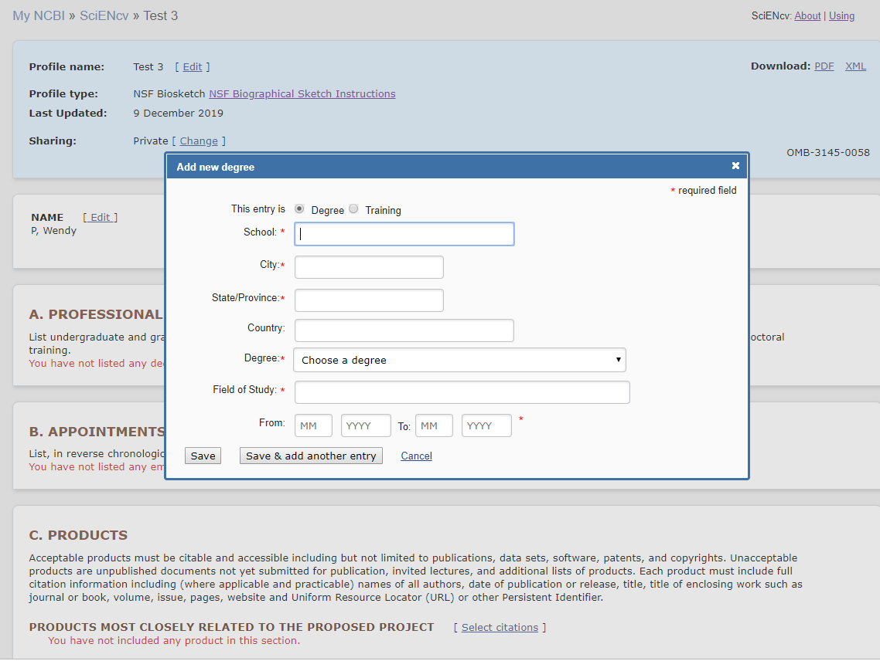
8. Degrees
Under professional preparation, select add one. Enter your academic degrees. Select save. For multiple entries, select Save & Add another entry.
To edit or delete, hover over selection and select either delete or edit.

Slide 21
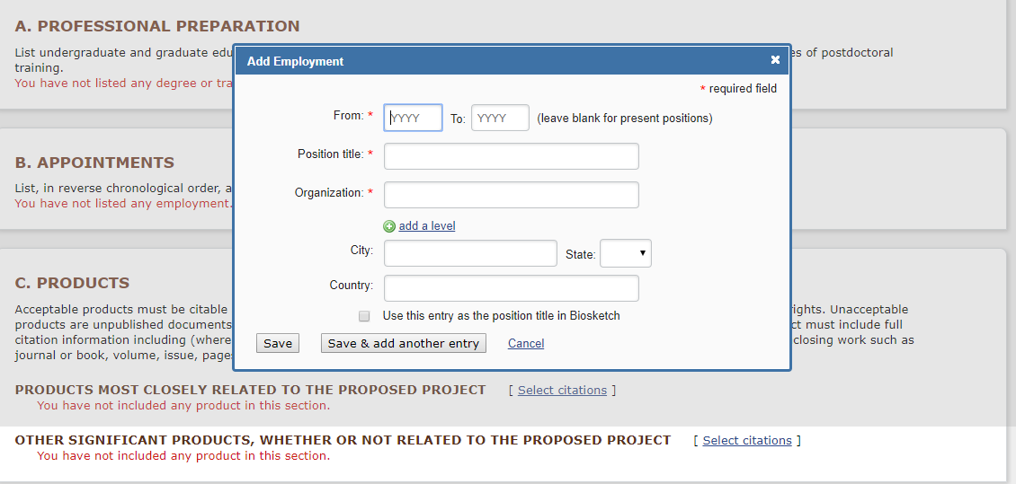
9. Appointments

Slide 22
10. Products (external content)
My Bibliography is your own personal bibliography. Delegated bibliographies can be found under Collections in My NCBI.)
If linked, you can also import from ORCID.
You can update on the spot and add/select publications to Biosketch

Slide 23
10. Products (external content)

Slide 24
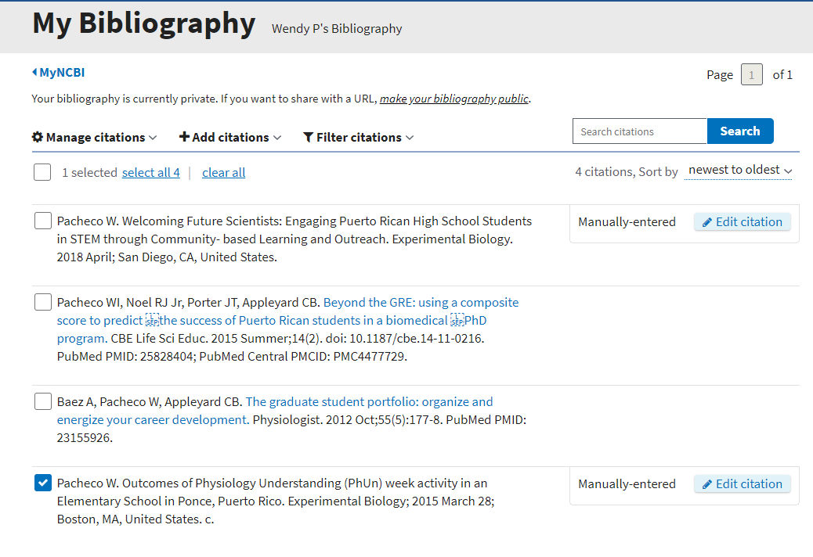
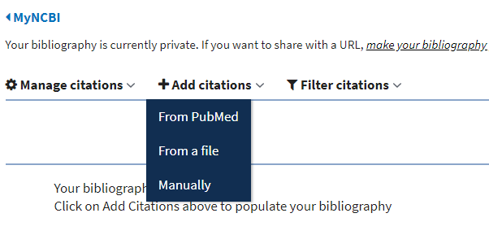
10. Products (external content)
Pub Med = search by topic, title or author
File = upload .ris, .txt or .nbib
Manual = choose from different products (patents, datasets, abstracts, etc.) and enter info in the fields

Slide 25
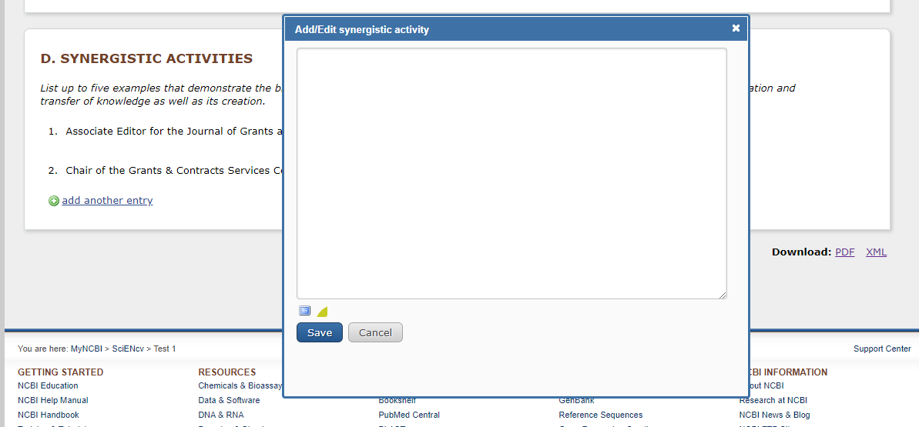
11. Synergistic Activities

Slide 26
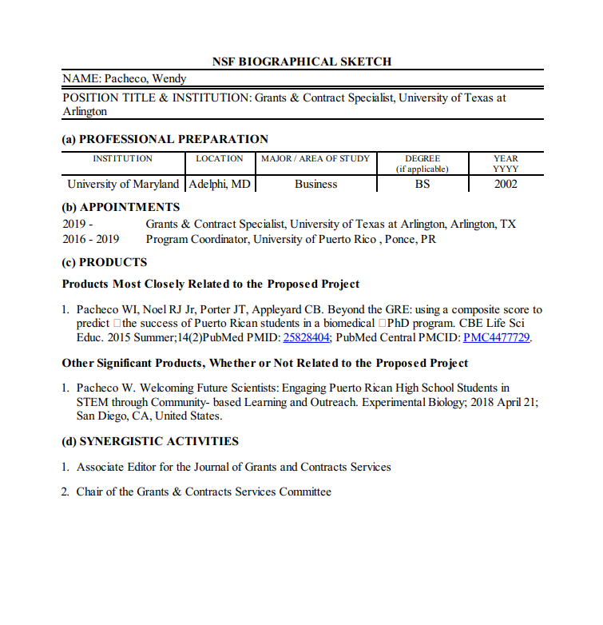
12. Download
PDF
DEMO!

Slide 27
Important reminders
One and done! Edit only as needed via SciENcv
PDF must not be edited
C & P will also use SciENcv
SciENcv will not check for NSF PAPPG compliance

Slide 28
A Compliant NSF Biosketch (PAPPG, Chapter II.C.2.f)
Is required for each Senior Personnel
Must be in the NSF-approved PDF format (sciENcv): Upon 2020 PAPPG release
Cannot exceed 2-page limit
Sections:
Professional preparation: Undergraduate, graduate and postdoctoral training (including institution, major, year)
Appointments: in reverse chronological order (beginning with the current)
Products: (can be publications, data sets, software, patents, and copyrights)
(i) up to five products most closely related to the proposed project;
(ii) up to five other significant products, whether related to the proposed project
d) Synergistic Activities:
up to five distinct examples that demonstrate the broader impact of the individual’s professional and scholarly activities (integration, transfer or creation of knowledge). Examples should be specific.
Multiple components are not permitted.

Slide 29
Q & A preaward@uta.edu

Slide 30
References
SciENcv: NLM’s Fed-wide biosketch tool. Federal Demonstration Partnership May 2016. Neil Thakur, PhD Office of Extramural Research Bart Trawick, PhD National Center for Biotechnology Information, National Library of Medicine
Creating NIH Biosketches with SciENcv. Laurissa Gann, MSLS. Research Medical Library, The University of Texas MD Anderson Cancer Center, Feb 2017

